Slide 1
GAR
Session 08: The Legend of Zelda
Notes:
Welcome. Today we build The Legend of Zelda. The main topic: composition vs. inheritance.
Start by playing the finished game, Zelda7, before any code.

Slide 2
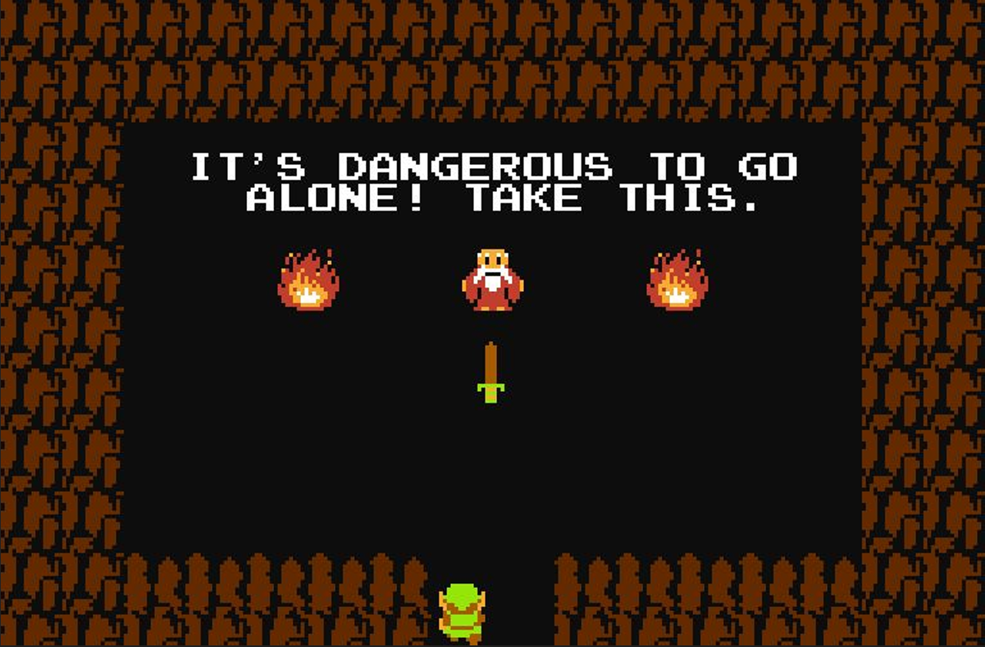
The Legend of Zelda
Notes:
The 1986 original: top-down, room by room. Ask who has played a Zelda.

Slide 3
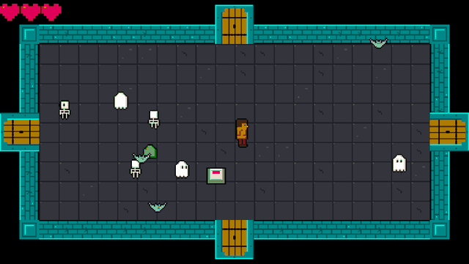
Today’s Goal
Notes:
Run Zelda7 and play it for a minute.
Ask: what would you need to build this? Collect answers on the board, and come back to them at the end.

Slide 4
Today’s Topics
Composition vs. Inheritance
Observer Pattern (Delegates & Events)
Hitboxes/Hurtboxes
A Tweening System
Dungeon Generation
Data-Driven Design (again)
Notes:
The main topic: composition vs. inheritance. With it: the Observer pattern and C# events, hitboxes, and a tweening system.

Slide 5
Source Code
github.com/Metamate/gar-games, folder 08-zelda
Its README: the steps (Zelda0 to Zelda7), a map of the code, how to run it
The course site: today’s concepts in full, the exercises, and questions to check yourself
Notes:
Open gar-games/08-zelda live. Show the README: the step table, the code map, how to run a step.
Say: the site explains the ideas, the README helps you find them in the code, the slides are for today.

Slide 6
Steps
Zelda0: rooms generated as tilemaps
Zelda1: the player, top-down movement
Zelda2: enemies and AI
Zelda3: combat (hitboxes, hurtboxes and damage)
Zelda4: events (player death, the floor switch and doorways)
Zelda5: screen scrolling between rooms
Zelda6: stenciling the door arches
Zelda7: audio (the finished game)
Notes:
The eight steps, one idea each. The README has the same table with more detail.

Slide 7
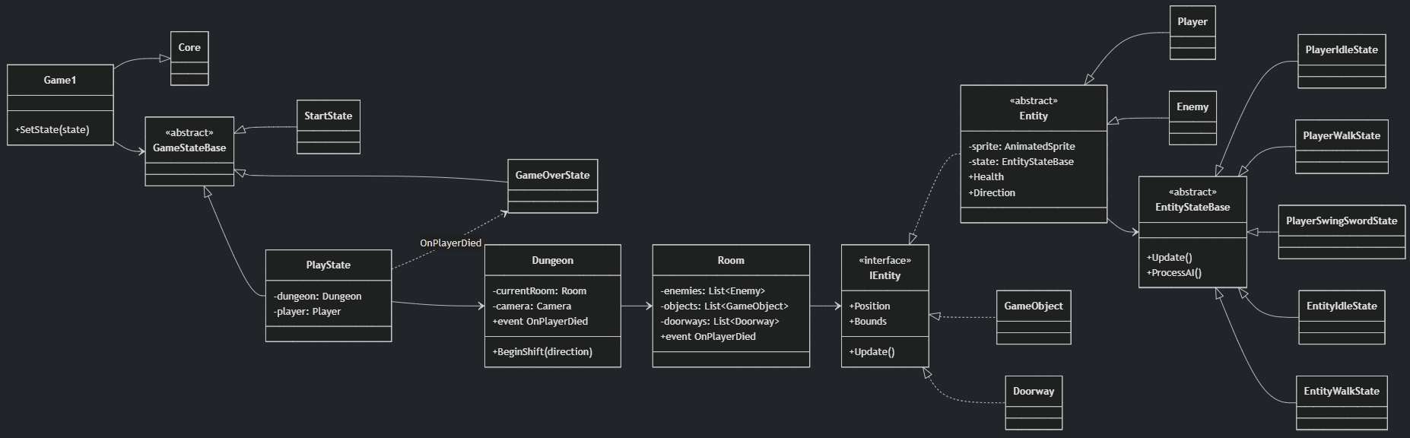
Diagram
Notes:
The finished game’s main classes. Don’t read it all: find Entity, Player, Enemy, Room and Dungeon.

Slide 8
Explore the Codebase
Take ~15 minutes to browse the finished game, Zelda7. Use the README as a guide if you need it.
Find where the game transitions between the title screen, gameplay, and game over
How does the player move?
Find where a new room is generated and what it contains when it is created
The player and enemies share a lot of code
  Find the common base and explain what it provides
Trace what happens from the moment the player presses the spacebar to an enemy taking damage
Notes:
Fifteen minutes in pairs with Zelda7 and the README’s code map. Take answers to two or three of the questions afterwards.

Slide 9
Composition vs. Inheritance
An enemy that flies, one that shoots, one that does both. Where do they go?
Entity
Enemy
FlyingEnemy
ShootingEnemy
ExplodingEnemy
FlyingShootingEnemy? copy code, or move it all up?
“Favor object composition over class inheritance.” Gang of Four
Notes:
Build the tree with them: Enemy, then flying, shooting and exploding enemies. Then ask: an enemy that flies and shoots?
Copy the code, or move it up into Enemy until every enemy carries everything. Neither is good.

Slide 10
Composition in Zelda
Zelda already composes: ask whether it’s what something is, or what it can do.
Behaviour in state objects
an enemy’s AI is the state
it holds, not the Enemy class
Behaviour wired from outside
a switch is a plain GameObject;
the room attaches OnCollide
Data instead of subclasses
enemy types come from XML,
not one class each
Plants vs. Zombies takes this all the way: the Component pattern.
Notes:
Zelda already composes in three ways; go through the boxes.
The question to keep asking: is this what something is, or what it can do? Plants vs. Zombies takes it all the way.

Slide 11
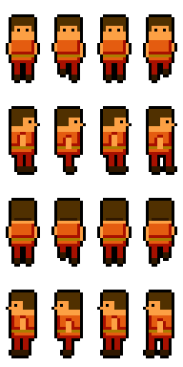
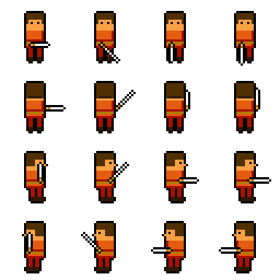
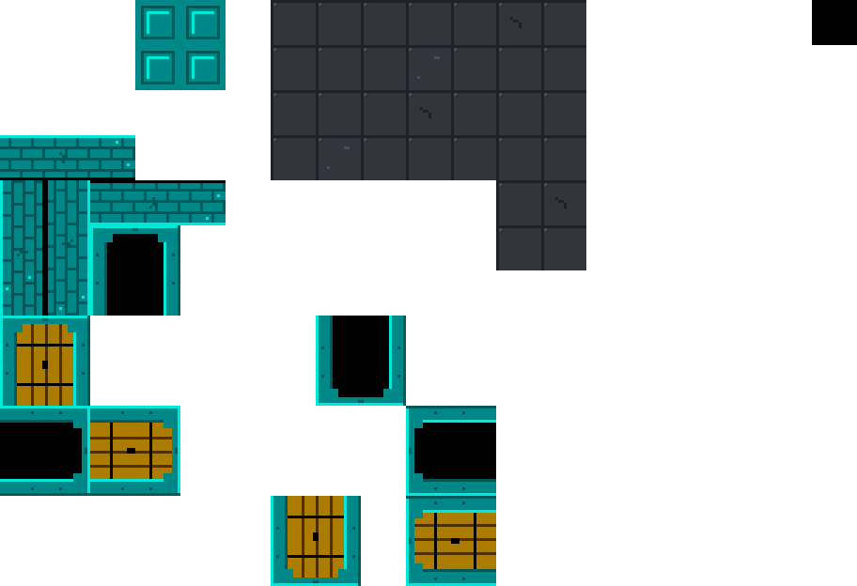
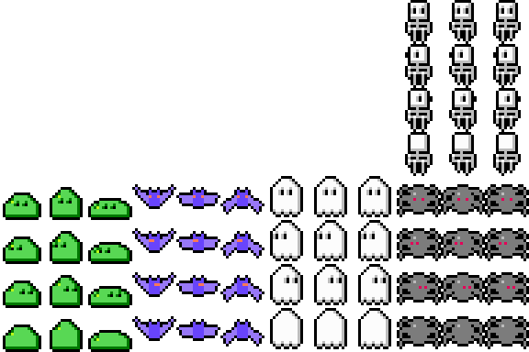
Assets
Notes:
The sheets: tiles, the player walking and swinging, and the monsters. Not all on the same grid size.

Slide 12
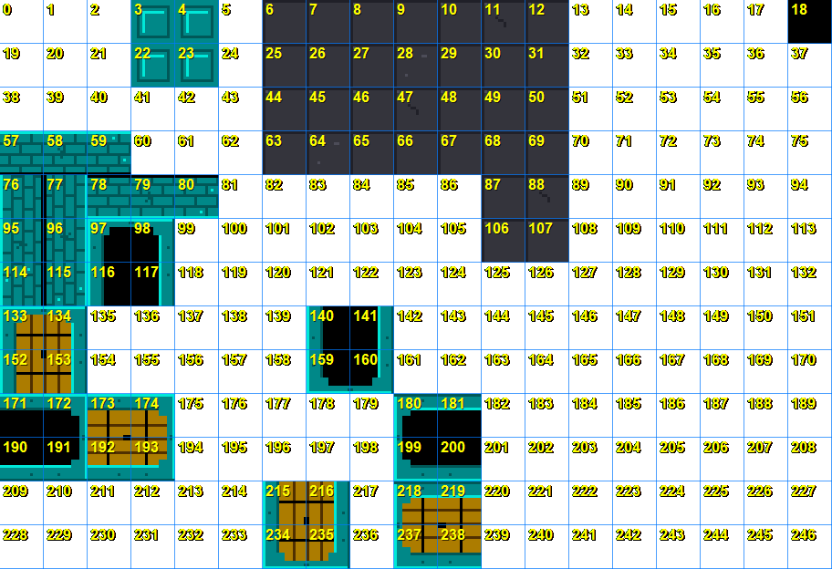
Tooling
Notes:
LabelTiles writes each tile’s number onto a copy of the sheet. The XML refers to tiles by number; nobody can read those off an image. Small tools like this are common in game projects.

Slide 13
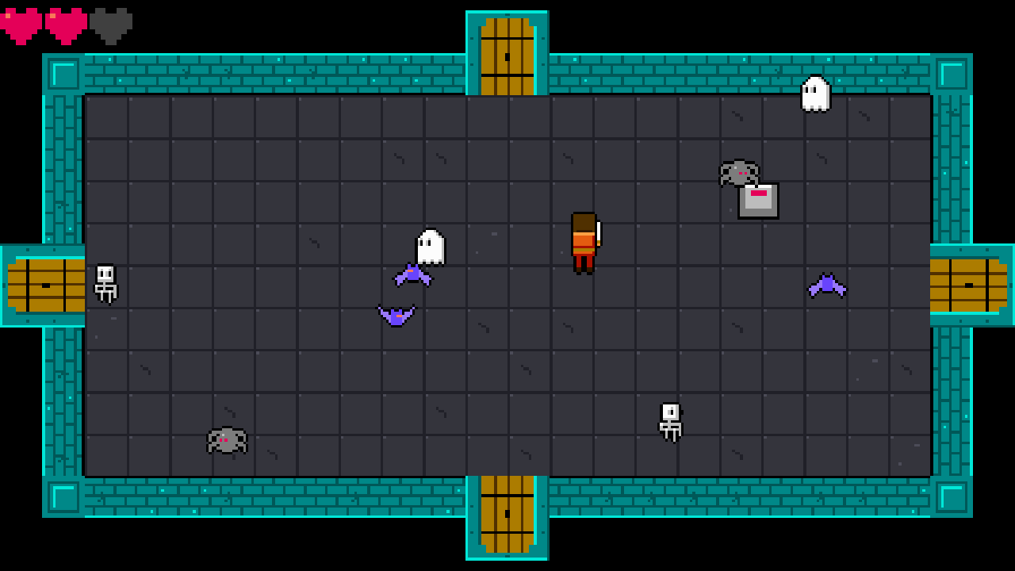
Top-Down Perspective
Notes:
The sprite is drawn higher than its collision box, so characters stand on the floor. Point at the player’s feet.

Slide 14
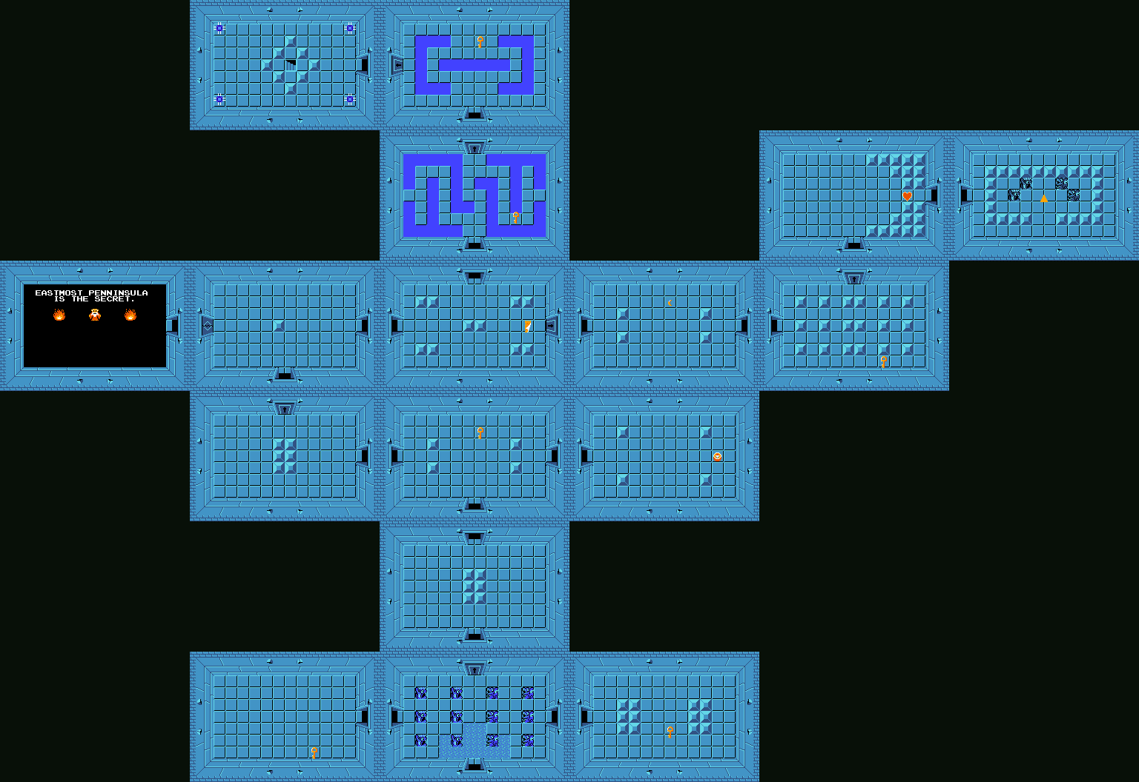
Dungeon Generation
Dungeon Maps
Notes:
Real dungeon maps: rooms connected by doors. Ours is simpler: an endless series of rooms.

Slide 15
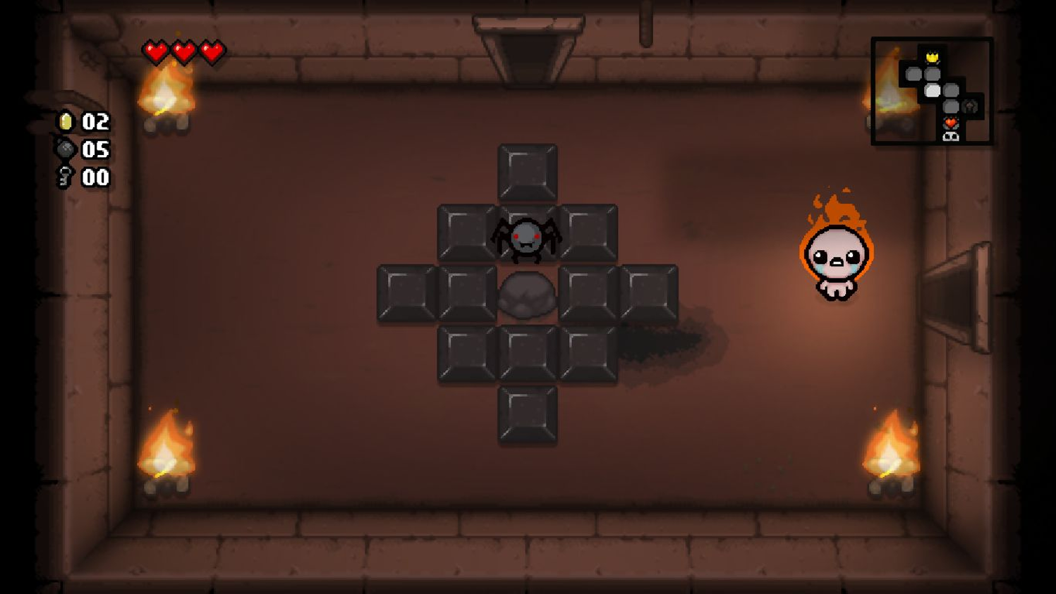
Dungeon Generation
Notes:
Each room is generated when entered: walls, a random floor, enemies, a switch and doors.

Slide 16
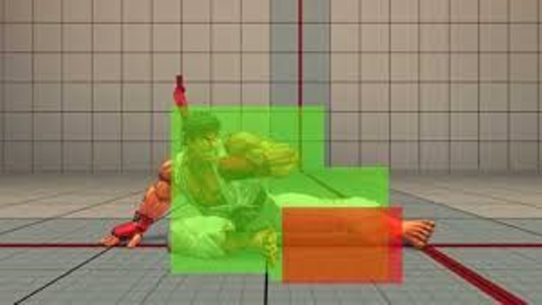
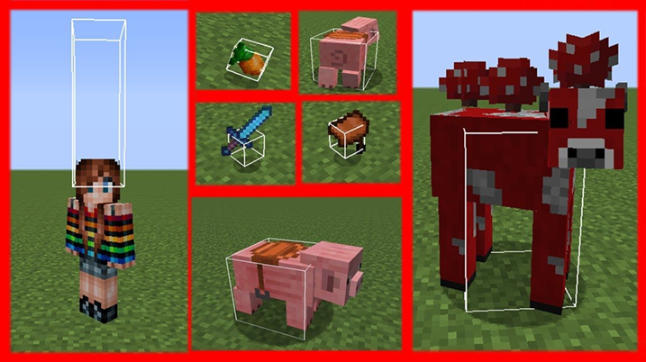
Hitboxes/Hurtboxes
Hitbox
Hurtbox
Notes:
A hitbox deals damage (the sword), a hurtbox receives it (the body). Separate, so reach and body don’t have to match the sprite.
Show F1 debug drawing in the game.

Slide 17
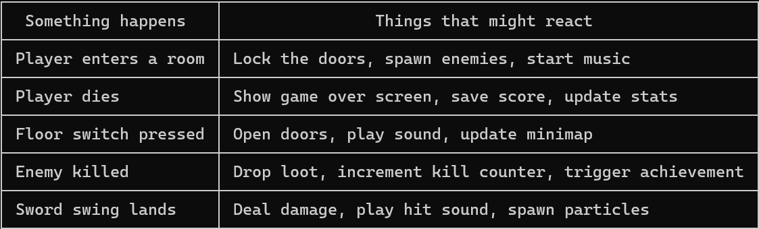
Events in Games
Games are full of moments where something happens and other things need to react
The thing that happened shouldn't need to know what those other things are
Events let you flip that around: the trigger just announces, anything that cares subscribes
Notes:
Something happens, and other things need to react. The thing that happened shouldn’t need to know them.
Ask: list moments in a game like this. Health changes, an enemy dies, a room clears, the sword swings.

Slide 18
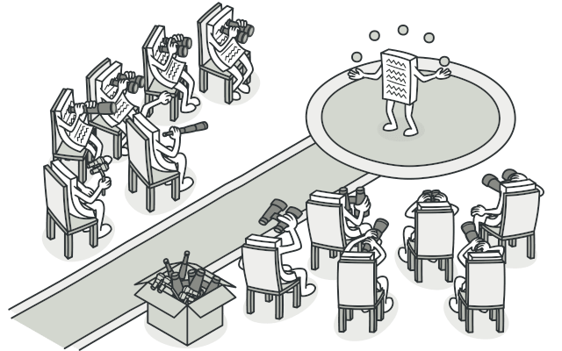
Observer Pattern
Notes:
The subject announces; observers subscribe. The dependency is flipped: the subject doesn’t know who listens.

Slide 19
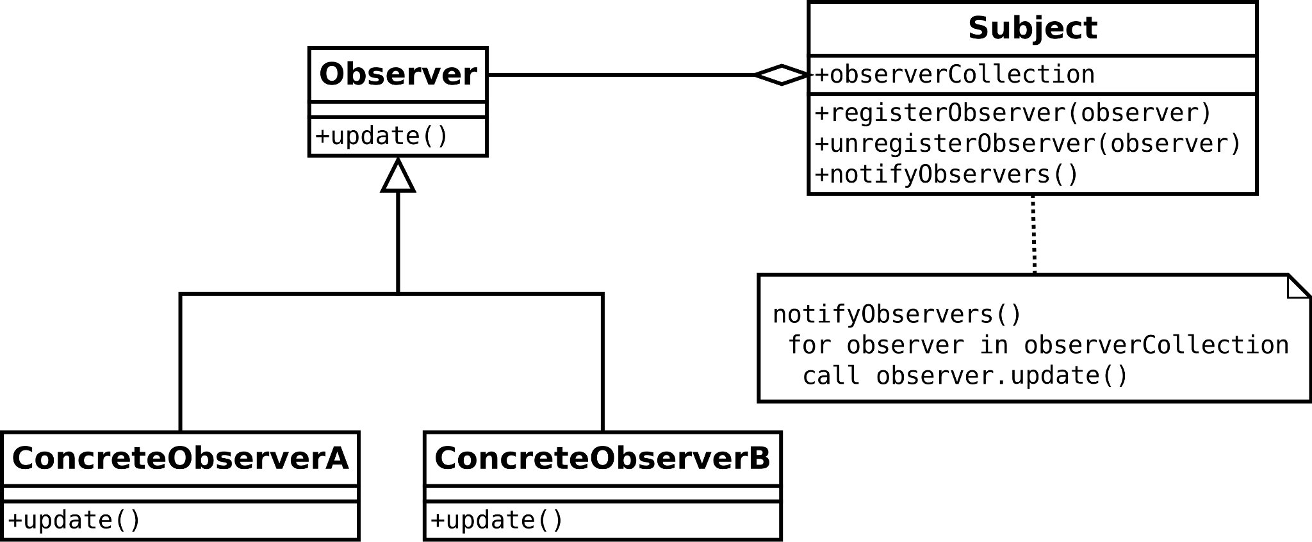
Observer Pattern
Notes:
The structure: a list of observers, and notify calls each.

Slide 20
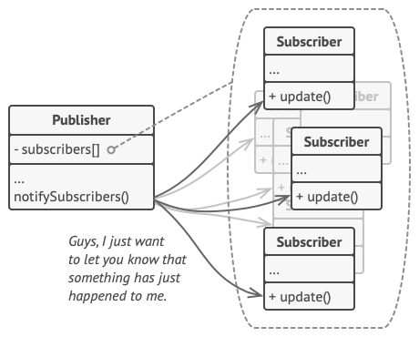
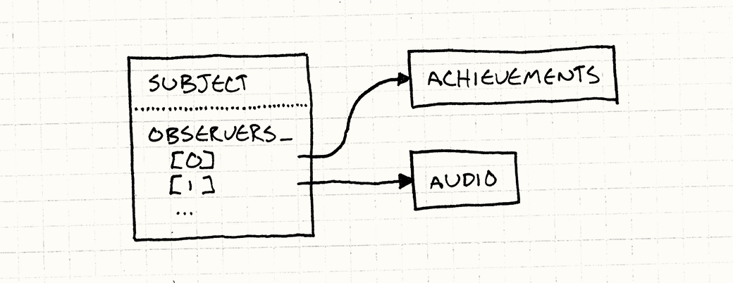
Publisher-Subscriber / Subject-Observer
Notes:
Two names for the same idea. Publisher-subscriber usually means there’s something in between.

Slide 21
However…
In C#, we don’t need to implement the observer pattern. Events are part of the language!
Notes:
In C# we don’t write the pattern ourselves: delegates and events are part of the language.

Slide 22
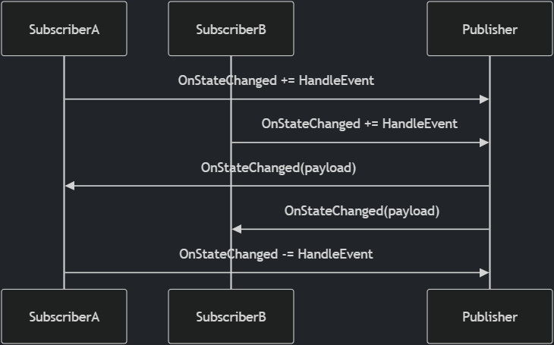
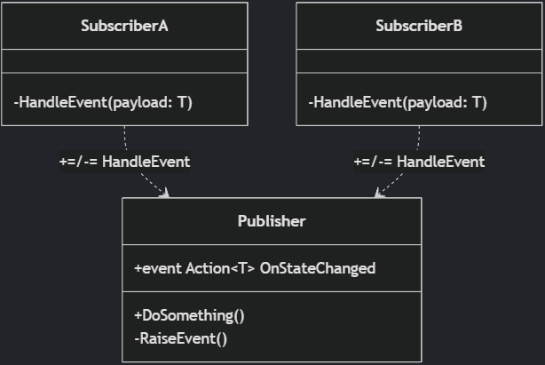
C# Events
Notes:
The same Observer structure, with C# events instead of an interface.

Slide 23
Delegates
A delegate is a variable that holds a reference to a method — call it later, from anywhere.
// Built-in delegate types:
Action // returns void, no args
Action<T> // returns void, takes T
Func<T> // returns T, no args
// GameObject.cs
public Action OnCollide { get; set; }
// Room.cs
switchObj.OnCollide += () => {
switchObj.State = "pressed";
foreach (var d in Doorways) d.IsOpen = true;
};
// Assign one handler
obj.OnCollide = () => Console.WriteLine("hit");
// Add multiple handlers
obj.OnCollide += () => PlaySound("hit");
obj.OnCollide += () => FlashRed();
// Call all subscribers
OnCollide?.Invoke();
Notes:
A delegate holds a reference to a method. Action and Func are the built-in ones. += adds a handler, Invoke calls them all.
Point at the switch in Room.cs: that’s where the room wires its door logic.

Slide 24
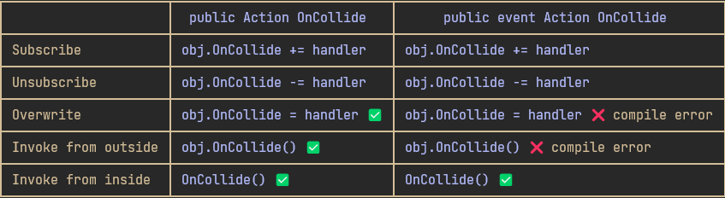
C# Events
An event is a delegate with guardrails
  under the hood it is a delegate, but the event keyword restricts what outside code can do with it
Notes:
An event is a delegate with guardrails: outside code can only += and -=. The owner fires; everyone else listens.

Slide 25
Lambda Expressions
(parameters) => expression
A lambda is an anonymous function
  A function defined inline, without a name
A short piece of behaviour in one place without declaring a whole method for it
Implicit return
Common use: passing behaviour as an argument, or subscribing to events
bool IsEven(int n) { return n % 2 == 0; }
// The same thing as a lambda
(int n) => n % 2 == 0
Notes:
A lambda: a function without a name, written where it’s used. The same IsEven, twice.

Slide 26
Lambda Expressions & Events
switchObj.OnCollide += () =>
{
if (switchObj.State == "unpressed")
{
switchObj.State = "pressed";
foreach (var d in Doorways)
d.IsOpen = true;
}
};
The lambda captures variables from its surrounding scope
  E.g. switchObj & Doorways. This is called a closure.
Without lambdas, the switch behaviour would need to be a separate named method that somehow still had access to switchObj and Doorways
Notes:
The switch handler captures switchObj and Doorways from the room: a closure.
Ask: what would this look like as a named method? It would need both as fields or parameters.

Slide 27
Making Zelda (more) Event-driven
Pick one and make it event-driven. The class firing the event must not know who reacts.
OnPlayerDied: trace the chain from the room to the game-over screen
Enemy death: what could react to an event for it?
SoundManager.PlaySound is called from many classes. How would events help?
Notes:
Exercise: pick one of the three and refactor it. The class firing the event must not know who reacts.
The OnPlayerDied chain is the one to trace first: room, dungeon, play state.
Full instructions are on the course site; students work from there. Walk round while they work.

Slide 28
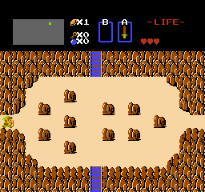
Screen Scrolling
Notes:
The original’s scroll between rooms. How would you build this?

Slide 29
Tweening
Tweening: move a value from A to B over time, instead of snapping it there.
linear
ease-out
The same nine frames. Where the dots bunch up, the value moves slowly.
More curves: easings.net
Notes:
A tween moves a value from A to B over time. The dots are nine frames of the same move: evenly spaced for linear, bunched up at the end for ease-out.

Slide 30
Linear Interpolation
Linear interpolation: the simplest curve.
lerp(a, b, t) = a + (b - a) * t // t from 0 to 1
t = 0
a
t = 0.5
halfway
t = 1
b
Works on anything numeric: positions, colours, angles.
Notes:
lerp: a plus a fraction of the way to b. t = 0, a; t = 1, b. Works on positions, colours, angles.

Slide 31
Screen Scrolling
The next room waits one screen away. The camera moves, and the player walks with it.
This room
The next room
placed one screen away,
never moves
camera
_tweens.Tween(GameSettings.RoomShiftDuration)
.Add(t => /* move the camera */, 0f, 1f).Add(t => /* walk the player */, 0f, 1f)
.Finish(FinishShift); // the next room becomes the current one
Notes:
The next room is placed one screen away and never moves. The camera tweens towards it while the player walks through the door.
When the tween finishes, the next room becomes the current one.

Slide 32
A Tweening System
Games tween all the time: fades, flashes, menus, floating numbers
GMDCore gets a reusable TweenManager
  Tween: values from A to B over time
  After: run a method later
  Every: repeat at an interval
  Chaining: .Add() and .Finish()
No progress variable, no “is it done yet?” check
_tweens.Tween(duration)
.Add(t => _camera.Position =
Vector2.Lerp(from, to, t), 0f, 1f)
.Finish(FinishShift);
_tweens.After(0.5f, () => Flash());
_tweens.Every(0.1f, Blink).Limit(6);
// Every frame
_tweens.Update(gameTime);
Notes:
Games tween constantly, so GMDCore gets a TweenManager: Tween, After, Every, chained with Add and Finish. No progress variables anywhere.

Slide 33

Stenciling
Walking through a door, the player should go under the arch, not over it.
Pass 1: draw the rooms
as usual
Pass 2: mark the arches
in the stencil buffer, with no colour
Pass 3: draw the player again
only where nothing is marked
Notes:
Without it, the player is drawn over the door arch. Three passes: rooms; arch masks into the stencil buffer only; the player where nothing is marked.

Slide 34
Data Driven Design
Content in data, behaviour in C#: a new enemy is one XML block and a row of sprites.
<Enemy type="skeleton" width="16" height="16" walkSpeed="20" health="1">
<Animation name="walk-down" frames="9,10,11,10" interval="0.2" />
<Animation name="idle-down" frames="10" interval="0.2" />
</Enemy>
The definition classes read the XML once; the rest of the code never sees it.
GameObject has no if (type == "switch") anywhere.
Someone writes type="skelton". When do you find out?
Notes:
A new enemy is one XML block and a row in the sheet. Ask the question: someone writes type="skelton". When do you find out? At runtime, not compile time. That’s the cost.

Slide 35
Keys and Locked Doors
Start from Zelda7. Full instructions are on the course site.
Some enemies drop a key when they die: use an event
A locked state for doorways, in door_layouts.xml
A key opens a locked door for good; show the keys next to the hearts
Notes:
Exercise: keys dropped by enemies, and locked doors they open.
It joins the two ideas of the day: the key drop is an event, the locked look is data.
Full instructions are on the course site; students work from there. Walk round while they work.

Slide 36
Exercise: Composition
Sketch the class hierarchy for enemies that can walk, fly, shoot or explode, in any combination
Then sketch it with composition: which parts would an enemy have?
Implement one part
  E.g. a shooting behaviour that any enemy can be given
Notes:
Exercise: sketch the hierarchy, then the composition, then implement one part (a shooting behaviour any enemy can have).

Slide 37
Check Yourself
When does inheritance fit, and when is composition better?
Why does Observer suit UI code particularly well?
What is the difference between a delegate and an event in C#?
What is the cost of data-driven design?
The answers, and more questions, are on the course site.
Notes:
Ask one question at a time. Pairs discuss for a minute, then take two or three answers.
Expected answers (from the course site):
Q: When does inheritance fit, and when is composition better?
A: Inheritance fits when there is one clear "is a" axis and the shared behaviour is needed by every subclass. Composition fits when behaviours combine freely: instead of one subclass per combination, an object has the parts it needs, and they can even change at runtime.
Q: Why does Observer suit UI code particularly well?
A: The UI depends on the game data, but the game shouldn't depend on the UI. With events, the health bar subscribes to HealthChanged and gameplay code never needs to know a health bar exists. The UI also only updates when something actually changes.
Q: What is the difference between a delegate and an event in C#?
A: An event is a delegate that outside code can only subscribe to and unsubscribe from. Only the declaring class can invoke it or overwrite its subscriber list.
Q: What is the cost of data-driven design?
A: Errors move from compile time to runtime, you need loading and validation code, and behaviour is split between code and data files.

Slide 38
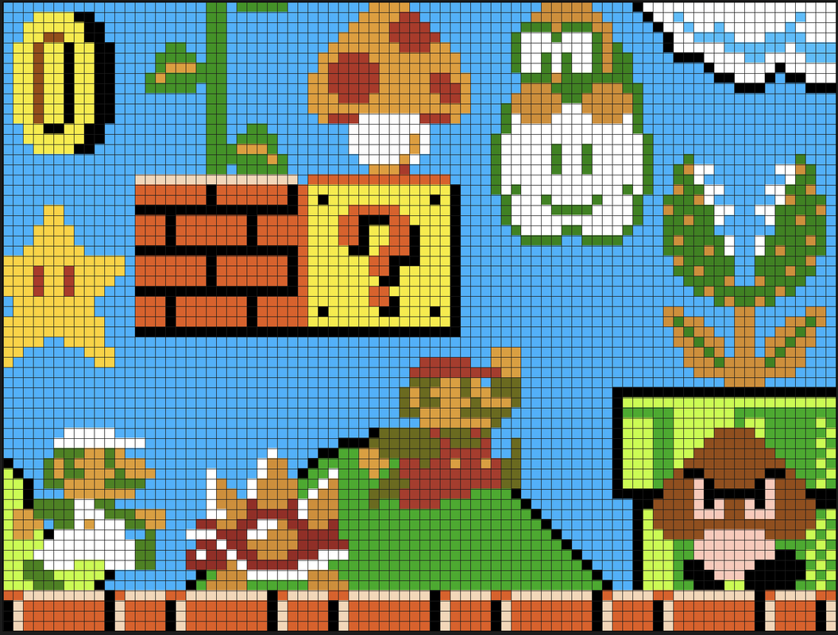
Apply It to Your Project
What are the meaningful moments in your game?
  The things that happen that other systems might care about
Map out at least two of them
  What fires the event, and what should react?
Is there anywhere a class knows too much about another?
  Could an event fix that?
Where does your game use inheritance?
  Is each subclass what something is, or what it can do?
Notes:
Give the project groups five minutes with these questions.
Ask two groups to share one answer each. Push for concrete classes and files, not intentions.

Slide 39
Your Course Project
Next milestone, by session 09: self-review
  Updated class diagram, list of patterns, and an event map
  The meaningful moments in your game: who fires them, who reacts
  At least one refactoring
Notes:
Next milestone by session 09: the self-review, with an event map of your game.

